Slide 1

School of Computer Science and Engineering
Department of Computer Engineering and Technology (DCET)
Full Stack Development Project
Panel-X
1032232953:Rishika Agarwal
1032233940:Khushi Singh
1262240002:Meghshyam Kimmatkar
1262240013:Vishakha Poojari

Slide 2
Problem Statement & Proposed Solution
PROBLEM STATEMENT:
❌ 91% plastic waste not recycled globally (UN Data)
❌ Complex recycling guidelines create user confusion
❌ No reward system for sustainable habits
❌ Lack of community engagement & accountability
❌ Low motivation for consistent eco-friendly actions
PROPOSED SOLUTION:
✅ ECOCOLLECT - Gamified recycling platform
✅ XP-based reward system with badges & streaks
✅ Real-time environmental impact tracking
✅ Interactive learning modules (Quizzes, Games)
✅ Community features for social accountability
✅ Behavioral psychology-driven design

Slide 3
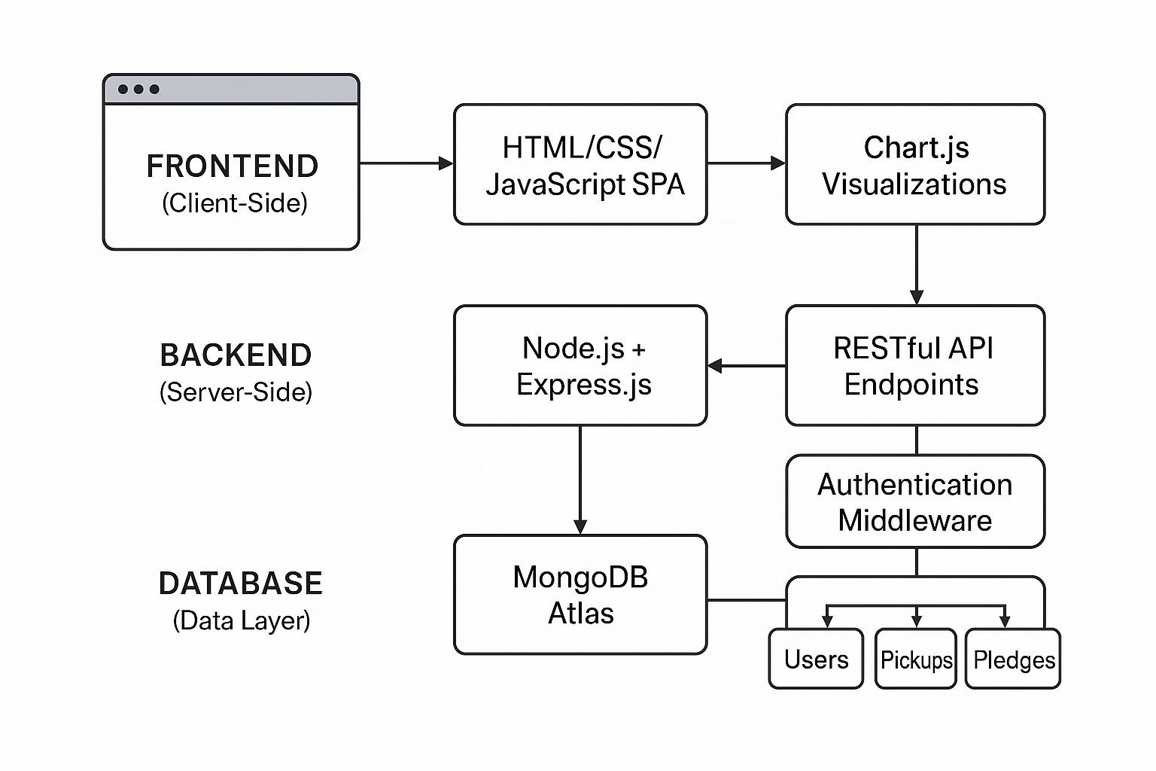
Process Flow Diagram & System Architecture
DATA FLOW:
User Action → API Call → Server Processing
Database Query → Data Processing → Response
UI Update → Real-time Charts → User Feedback
KEY PROCESSES:
User Registration/Authentication
Pickup Scheduling & Tracking
XP Calculation & Badge Assignment
Community Leaderboard Updates

Slide 4
Technical Stack with Reasoning
FRONTEND TECHNOLOGIES:
HTML5/CSS3/JavaScript - Lightweight, no framework overhead
Bootstrap 5.3.0 - Responsive design across devices
Chart.js 4.4.1 - Interactive data visualizations
BACKEND TECHNOLOGIES:
Node.js + Express.js 4.21.2 - Fast, non-blocking I/O
RESTful API Design - Clean separation of concerns
CORS Middleware - Cross-origin resource sharing
DATABASE & DEPLOYMENT:
MongoDB Atlas - Cloud-based, scalable NoSQL
Mongoose 7.8.7 - Schema validation and modeling
Environment Variables - Secure configuration
REASONING:
✅ Single Language (JavaScript) full-stack
✅ Cloud-native for scalability
✅ Real-time capabilities

Slide 5
Challenges Faced during development if Any
Challenges | Solution
Complex UI State | Centralized Data Management
Real-time Sync | Optimized REST APIs
Reward Balance | Tiered XP System
Performance | Efficient Animations
Mobile Responsive | Bootstrap Grid

Slide 6
Limitation and scope of the project with future projection extension
🌍 LONG-TERM (1-2 Years)
Multi-platform deployment
Smart city integration
Carbon credit marketplace
⚡ SCALABILITY
Microservices ready
Docker containerization
Global CDN support
🔸 CURRENT LIMITATIONS
Local Storage only
Basic mobile features
Limited integrations
🚀 IMMEDIATE (3 Months)
MongoDB Cloud migration
PWA + Push notifications
Enhanced mobile UX
📱 MEDIUM (6-12 Months)
Mobile app development
AI recommendations
IoT smart bin integration

Slide 7
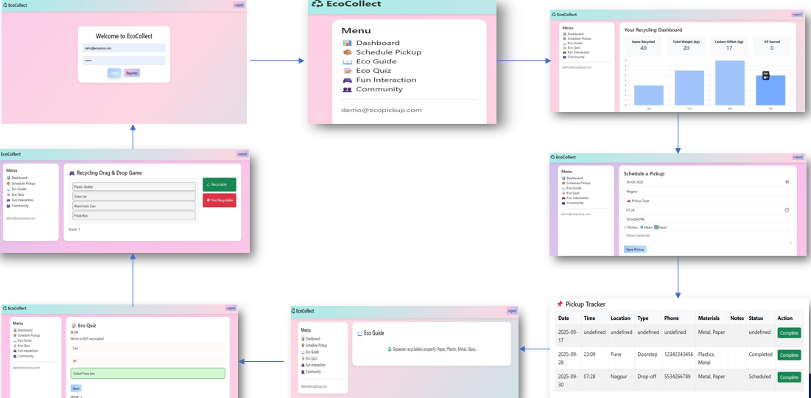
Working Demo

Slide 8
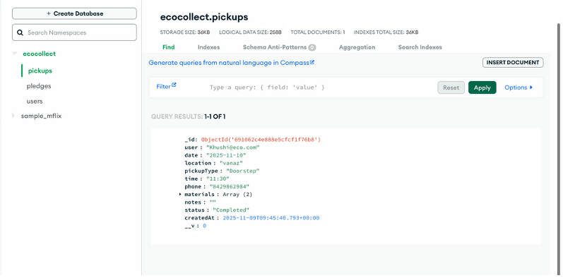
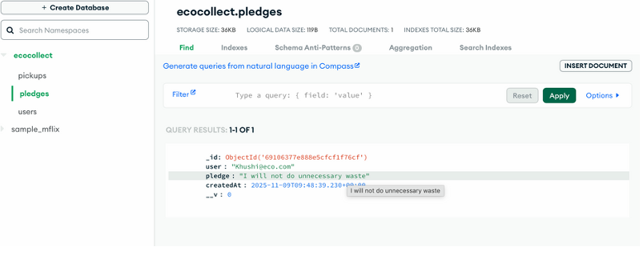
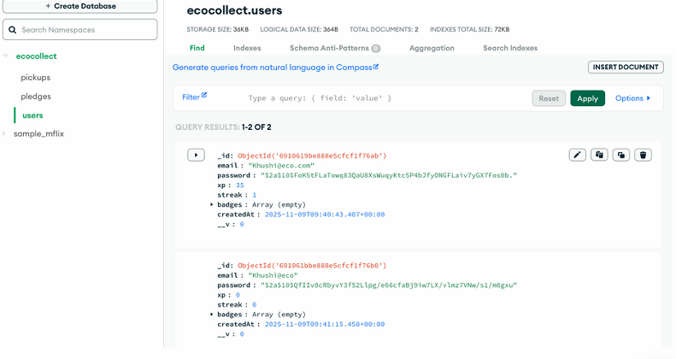
Mango DB Working Demo

Slide 9
Q/A
KEY PROJECT HIGHLIGHTS:
🎯 INNOVATION ASPECTS:
Gamification in environmental conservation
Behavioral psychology integration
Full-stack JavaScript implementation
Real-time impact visualization
📊 TECHNICAL ACHIEVEMENTS:
15+ RESTful API endpoints
Responsive SPA architecture
Secure authentication system
Efficient data management
🌍 SOCIAL IMPACT:
Measurable environmental benefits
Community engagement model
Educational value proposition
Scalable sustainability solution

Slide 10
THANK YOU

